Slide 2
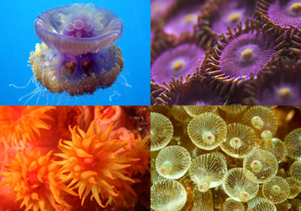
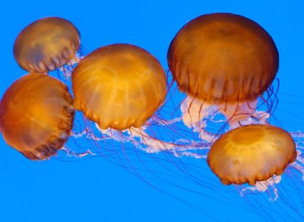
Cnidarians
Characteristics include:
Two cell layers
A saclike digestive tract
Tentacles
Radial symmetry (appendages arranged in a ring around the mouth)
Nerve net – simple nervous system (NO BRAIN!)
Invertebrates – no backbone

Slide 4
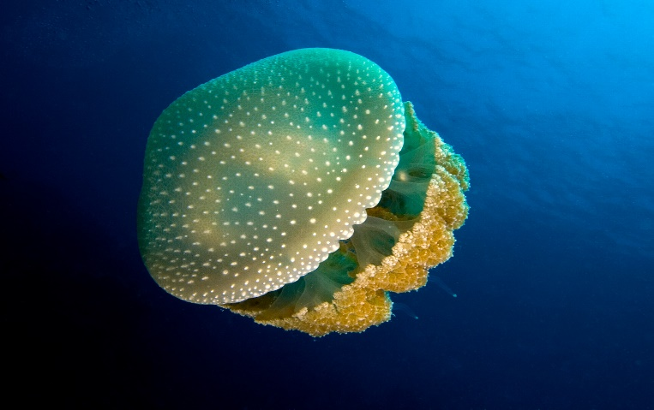
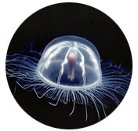
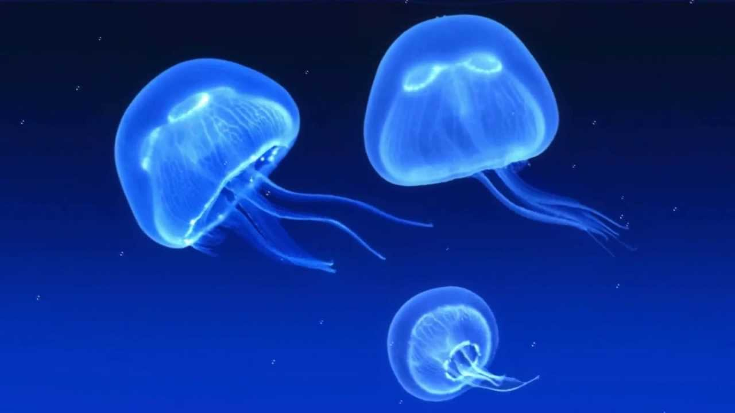
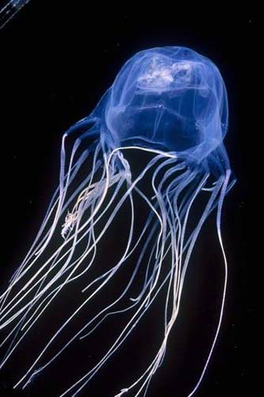
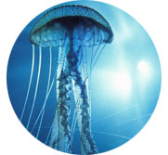
Class Scyphozoa
AKA – the swimming “jellyfish”
JELLYFISH ARE NOT FISH!!!
Most scientists just call them JELLIES.
Jellyfish Invasion video

Slide 5
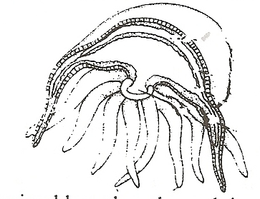
All have an umbrella shaped structure (the medusa) with tentacles hanging down from it
The medusa is composed of two layers
The epidermis
The gastrodermis
In between the epidermis and gastrodermis is the MESOGLEA – a jellylike mass – functions kind of like a skeleton – supports.
medusa
Mesoglea
Epidermis
Gastrodermis
Digestive cavity
Mouth
Tentacles

Slide 6
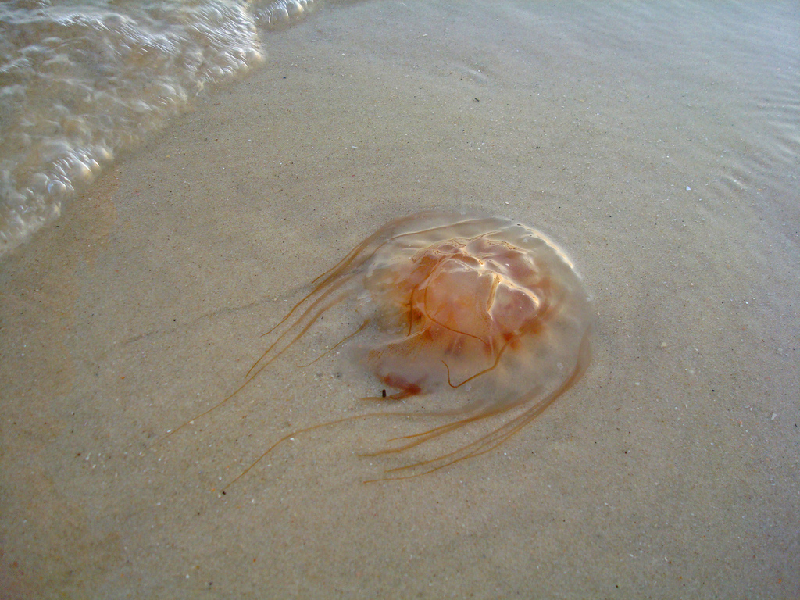
Part of the plankton population
BUT can contract medusa and pulsate gently through the water
Weak swimmers – they often strand on sandy beaches.

Slide 7
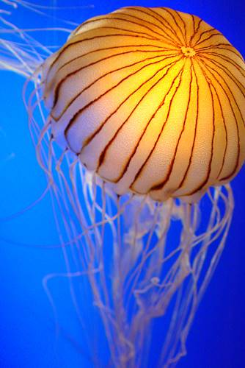
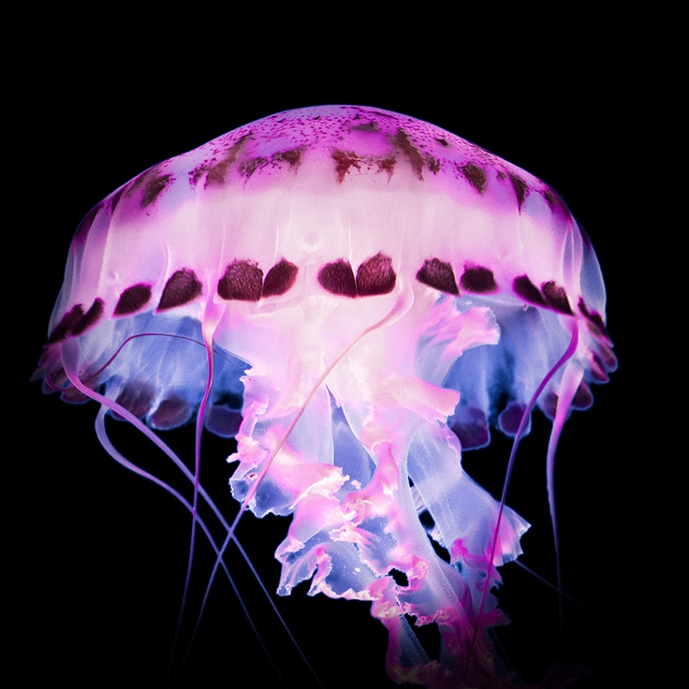
Do jellies breathe?
Respiration occurs through the “skin” by way of diffusion.
Oxygen diffuses from water to the cells
Carbon dioxide diffuses from the cells to the water

Slide 8
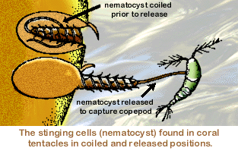
Feeding
Jellies contain stinging cells called cnidoblasts
Inside the cnidoblast there is a coiled thread with a barb at the end called a nematocyst.
Nematocysts are discharged by mechanical or chemical stimulus
When discharged into prey, it paralyzes it
Tentacles then bring food toward the mouth
Once digested, waste product are expelled back out through the mouth.
How Jellyfish Sting Video

Slide 9
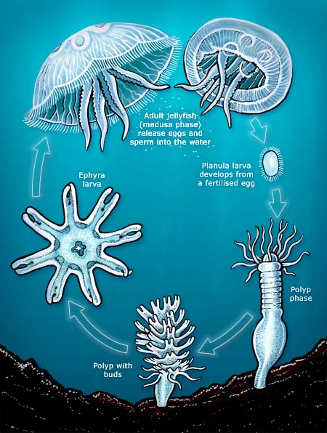
Life Cycle
Mature Medusa
Planula larva
Young polyp
Mature polyp
with buds
Ephyra or young
medusa

Slide 10
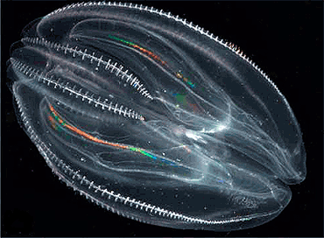
Comb Jellies
Phylum Ctenophora – NOT a cnidarian!
8 rows of cilia that look like combs
Cilia beats to move the animal through water
Bioluminescent
comb jellyfish video

Slide 11
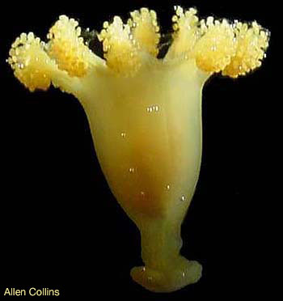
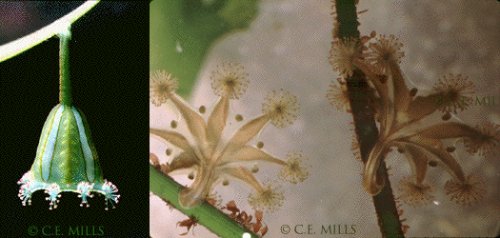
Class Staurozoa
The Stalked Jellies
No medusa stage – like the sea anemone
Live mostly in cold waters and some near deep sea vents

Slide 12
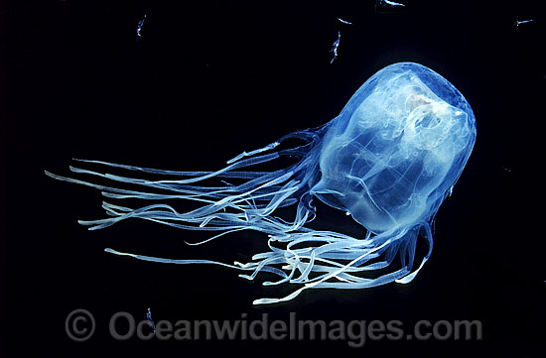
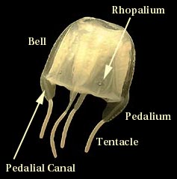
Class Cubozoa
The Box Jellies
Differ from true jellies
in the following ways:
Square shaped.
4 evenly spaced tentacles.
Well developed EYES.
But still – NO BRAIN.
Swim faster.
VERY POISONOUS –
like DEADLY poisonous.
Box Jellyfish video

Slide 13
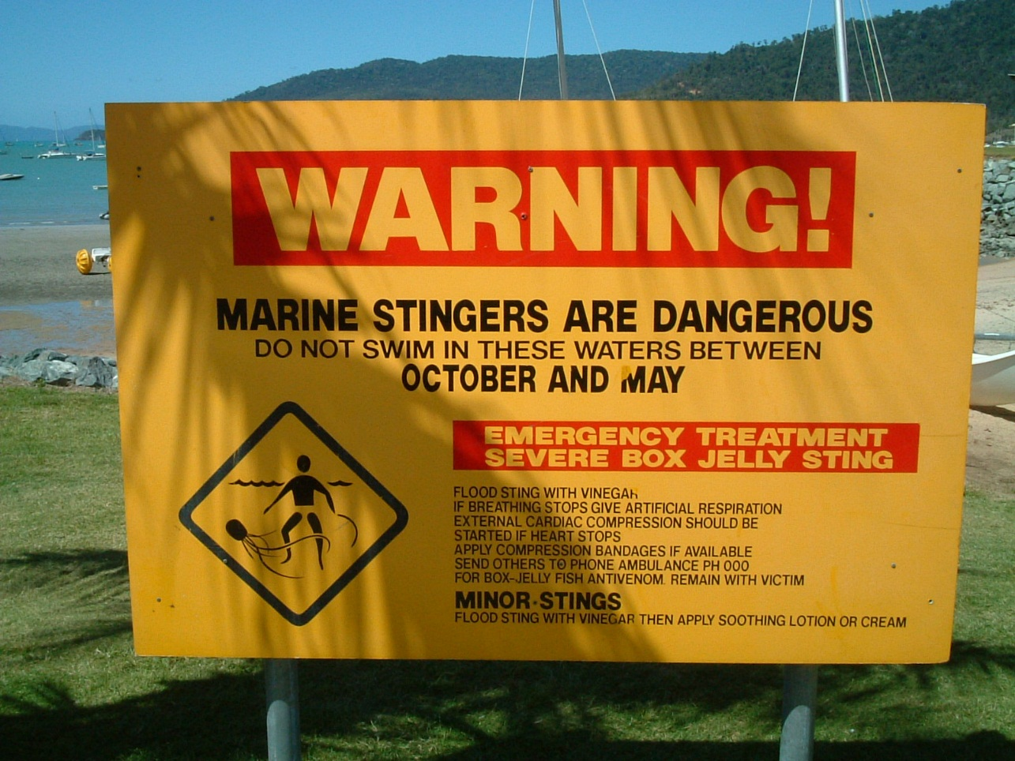
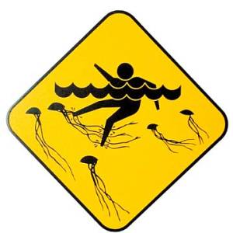
Two of the most dangerous cubozoans
Irukandji in Australia
Sea Wasp (Chironex fleckeri) in Australia
box jellyfish video

Slide 14
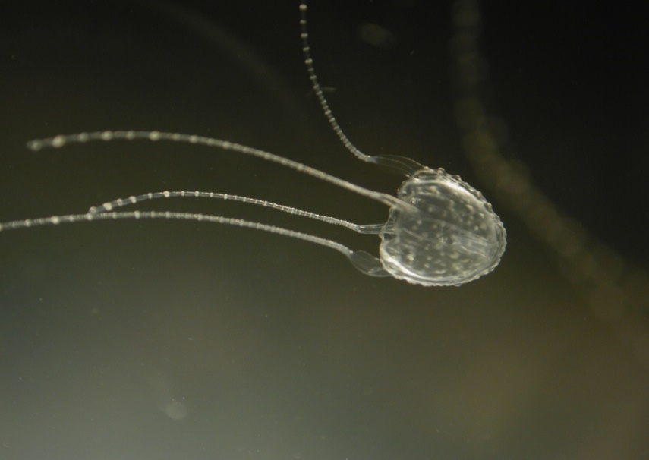
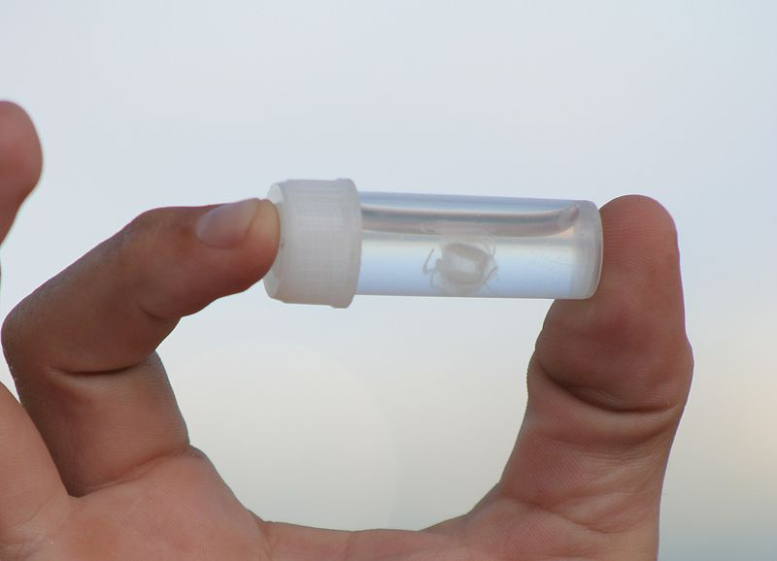
Irukandji (Carukia barnesi)
Habitat is usually deeper waters of Australia
Very small
Stings can be fatal
About 5-45 minutes after being stung, the person starts to have a severe backache or headache and shooting pains in their muscles, chest and abdomen. They may also feel nauseous, anxious, restless and vomit.
Irukandji box jellyfish video

Slide 15
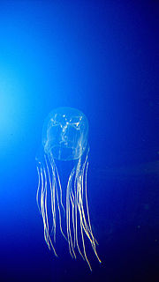
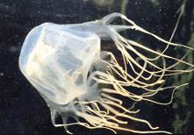
Sea Wasp (Chironex fleckeri)
In Australia - near shore in calm waters, mouths of rivers, estuaries and creeks following the rain
No chance of surviving the venomous sting, unless treated immediately. The pain is so excruciating and overwhelming that you would most likely go into shock and drown before reaching the shore.
Sea Wasp jellyfish video

