Slide 1
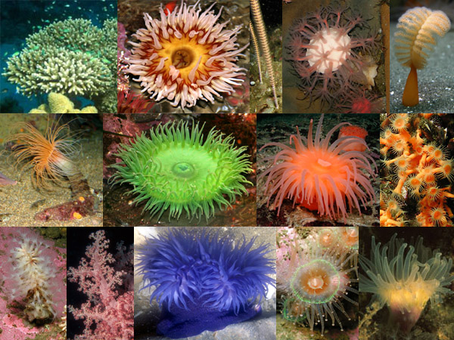
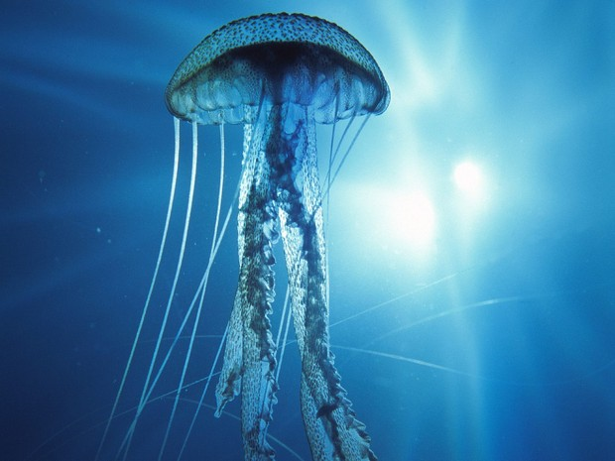
The Cnidarians Part 2

Slide 3
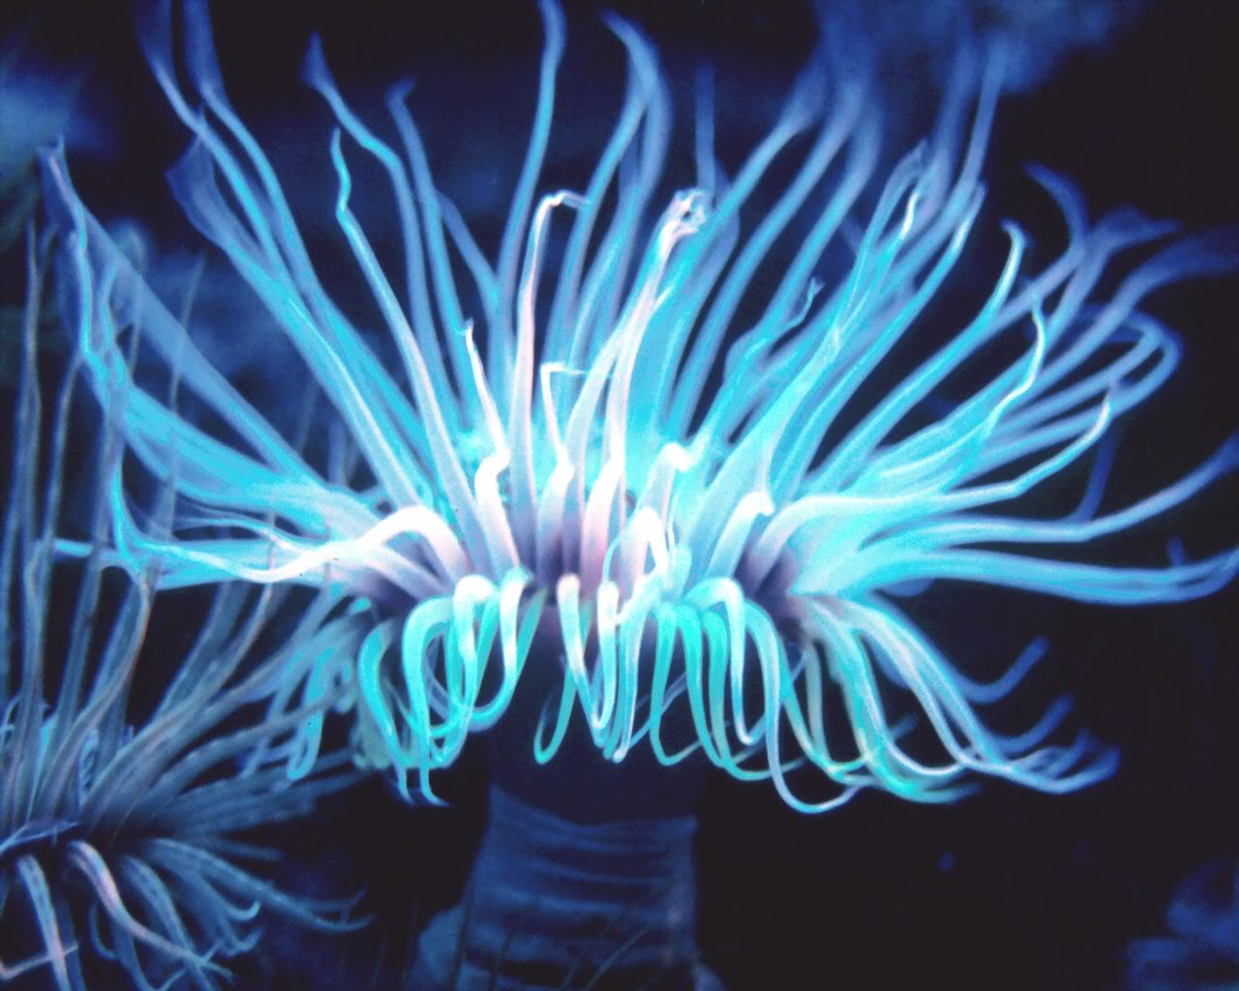
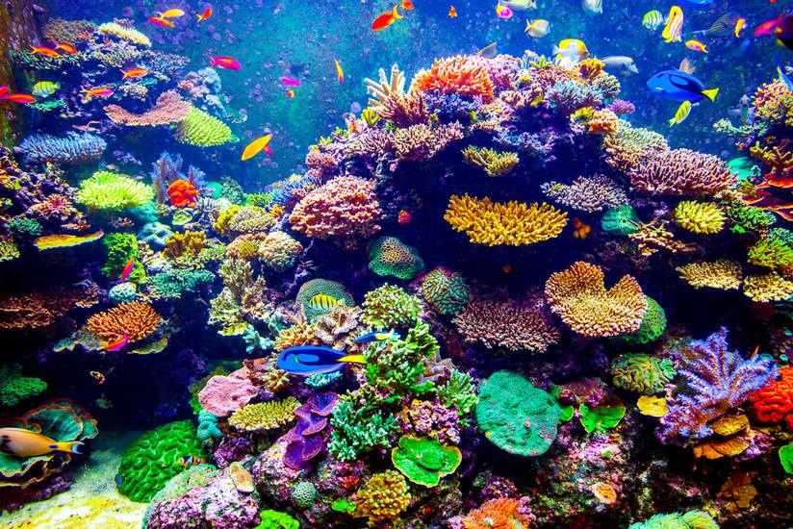
Class Anthozoa
Means “Flowering Animal”
Includes the sea anemones and corals

Slide 4
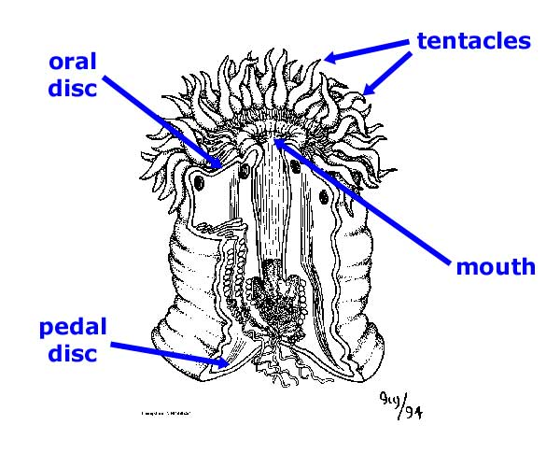
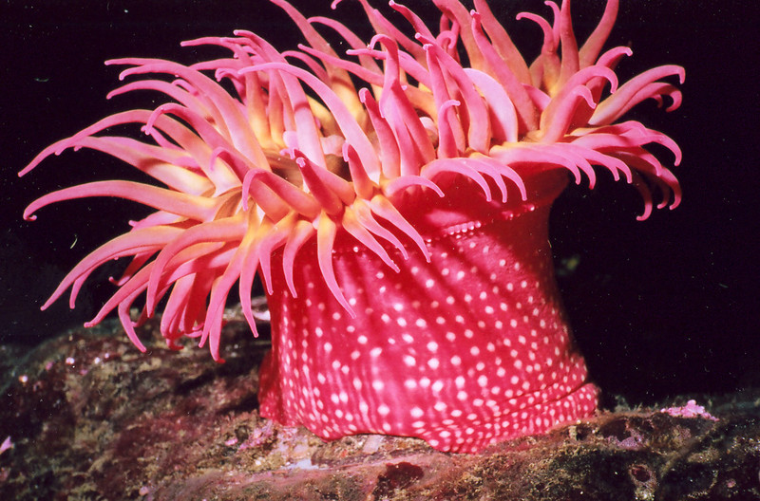
Sea Anemones
Stinging tentacles
Radial symmetry
Lives only as a polyp
(NO medusa stage)
Sessile
(or stationary)
Nerve net – simple
nervous system

Slide 5
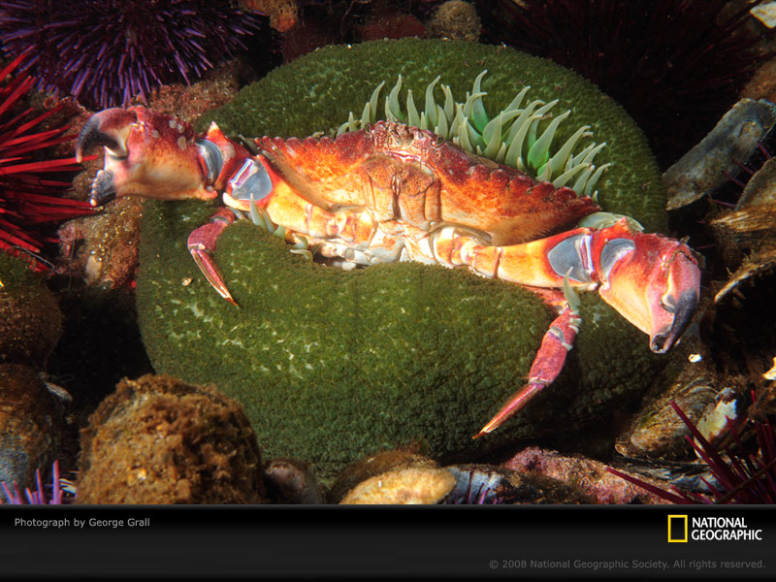
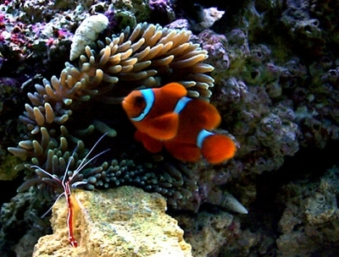
Sea Anemones Feeding
Use tentacles with nematocysts to paralyze prey
Some animals can live IN the anemone unharmed
The clownfish and some shrimp are SYMBIONTS with anemones
These are SYMBIOTIC RELATIONSHIPS

Slide 6
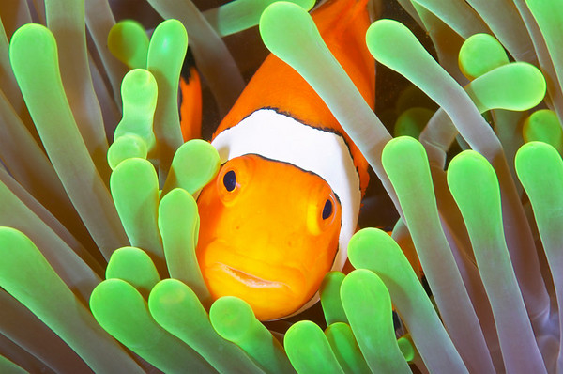
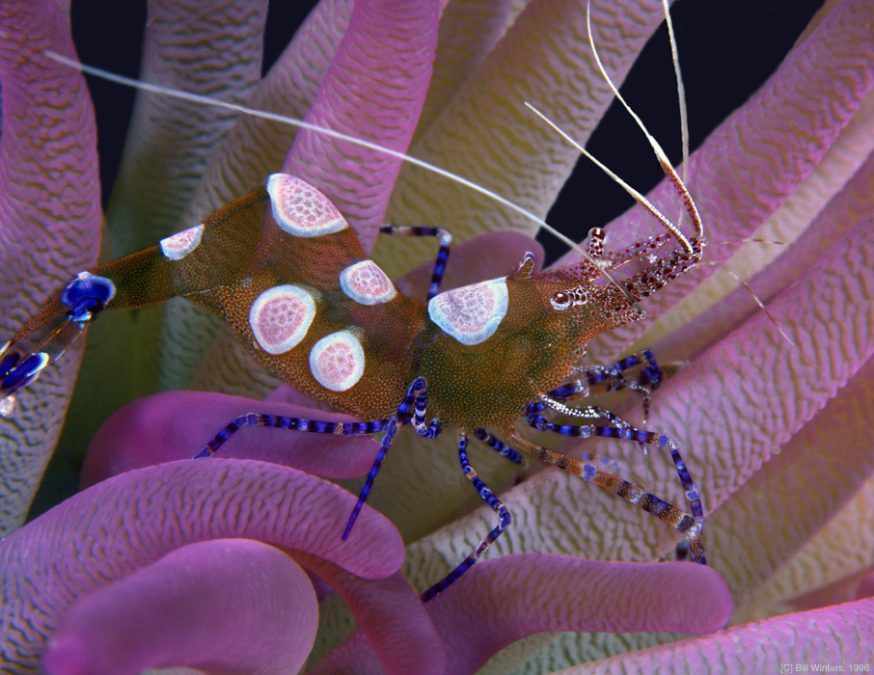
Clownfish gains protection from predatory fish while at the same time they protect the anemone’s tentacles from getting bitten off by other fish
The shrimp keeps the anemone clean and gains protection from predatory fish
Clown Fish and Sea Anemones video

Slide 7
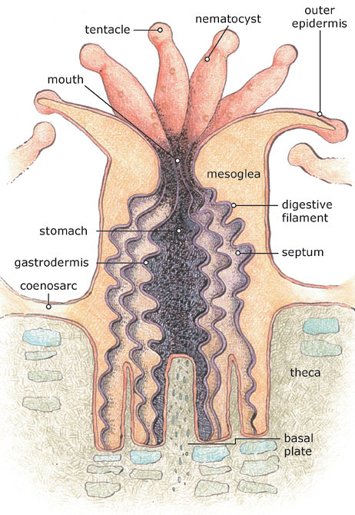
Corals
Basic polyp structure
Sac-like digestive tract
Mouth surrounded by stinging tentacles
Colonial animals – connected to each other by coenosarc
Calcium carbonate skeleton
Hard and soft corals

Slide 8
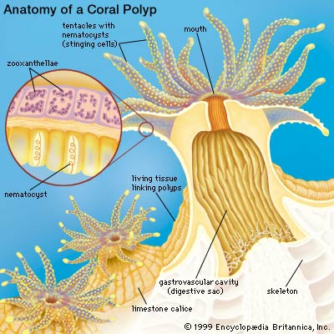
Symbiotic relationship with algae called zooxanthellae.
Zooxanthellae get a home and CO₂ from the coral.
Coral get O₂ and food (sugar) from the zooxanthellae by way of photosynthesis

Slide 9
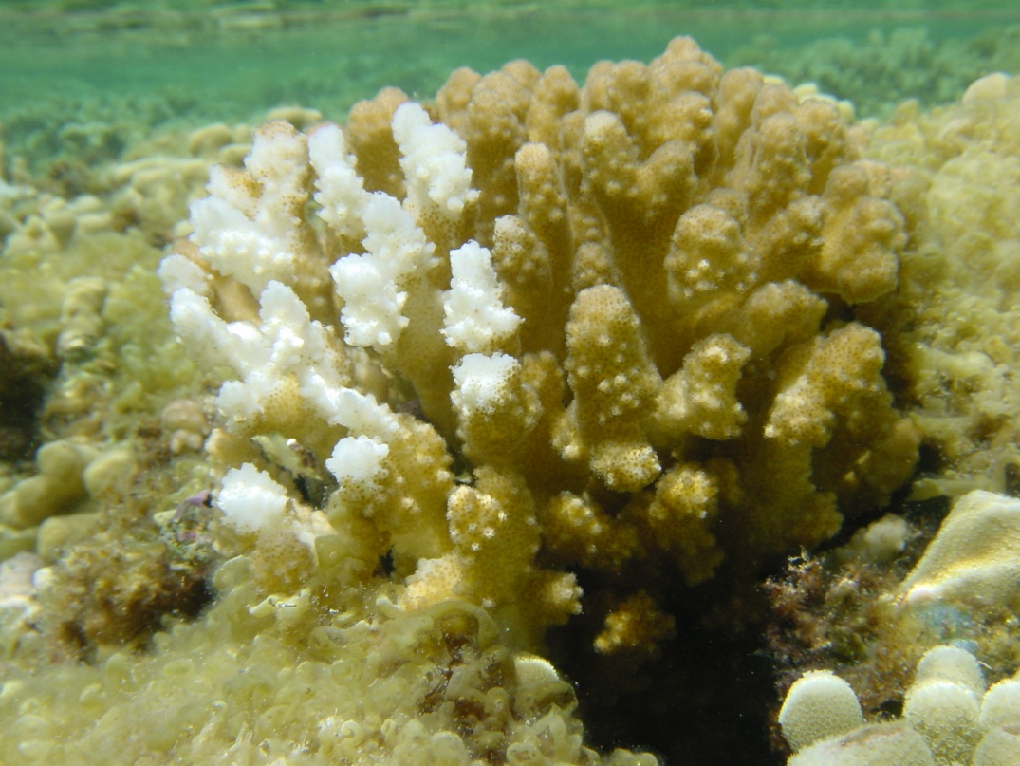
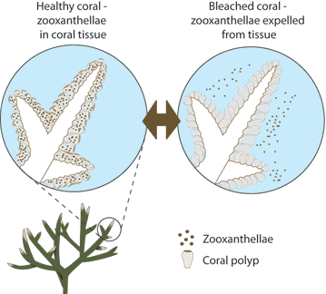
Coral bleaching – when the algae leaves the polyp - and the polyp may die
Causes of bleaching include pollutants, severe storms, unusually high or low temps, runoff, and sedimentation.

Slide 10
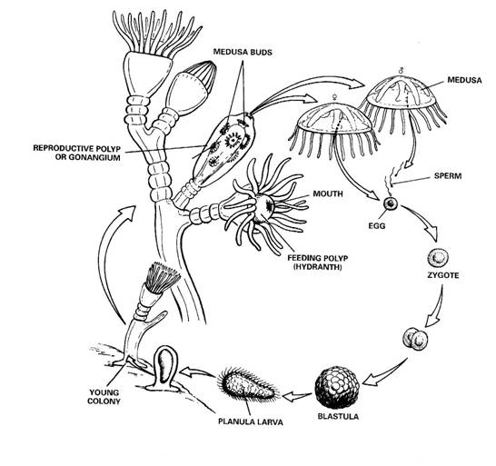
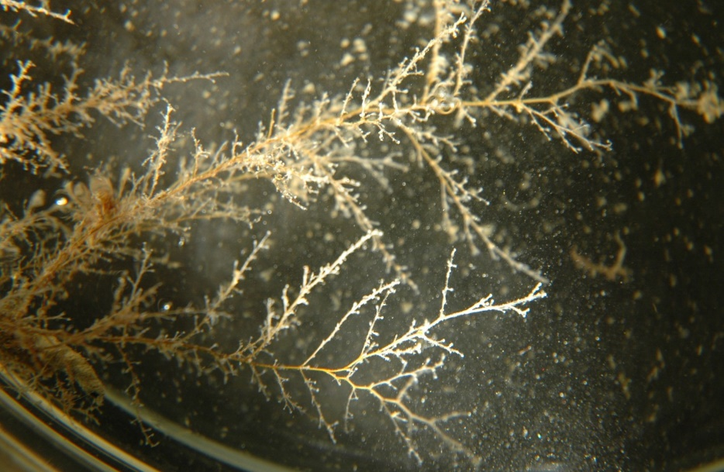
Class Hydrozoa
Hydra (Obelia)
Colonial animals
Two types of polyps – a feeding polyp and a reproductive polyp
Hydra life cycle includes
Planula
Medusa
polyp stage.
Dominant stage is the polyp stage

Slide 11
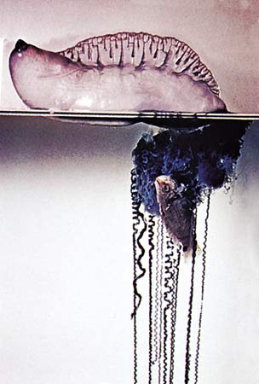
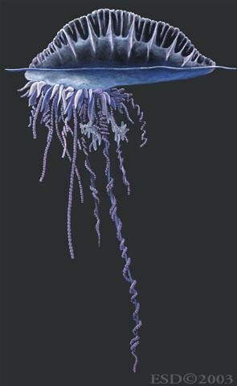
Siphonophores
Characterized by having many polyps – each with a different function
Portuguese man-of-war (Physalia)
Belongs to Hydrozoa and not Scyphozoa with the swimming jellies because it is a colony of many polyps.
Each polyp has a function:
One kind of polyp makes the gas filled bag
One kind of polyp makes the stinging cells
Other polyps digest food
Other polyps serve in reproduction
Portuguese man of war video

