Slide 1
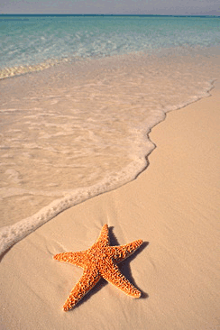
Ticket Out The Door
Name: _________________________
Period: ________________________
You and your friends are walking the beach in Galveston. As you are walking the shoreline, you see a starfish that has washed up on the beach. After picking up the starfish, you begin to explain the parts of the starfish to your friends. In your own words, explain what you would tell your friends.
______________________________________________________________________________________________________________________________________________________________________________________________________________________________________________________________________________________________________________________________________________________________________________________________________________________________________________________________________________

Slide 2
Ticket Out The Door
Name: _________________________
Period: ________________________
You and your friends are walking the beach in Galveston. As you are walking the shoreline, you see a starfish that has washed up on the beach. After picking up the starfish, you begin to explain the parts of the starfish to your friends. In your own words, explain what you would tell your friends.
______________________________________________________________________________________________________________________________________________________________________________________________________________________________________________________________________________________________________________________________________________________________________________________________________________________________________________________________________________

