Slide 1
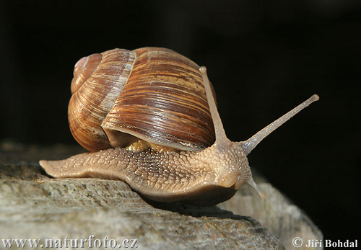
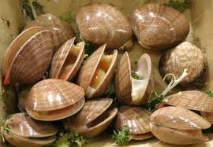
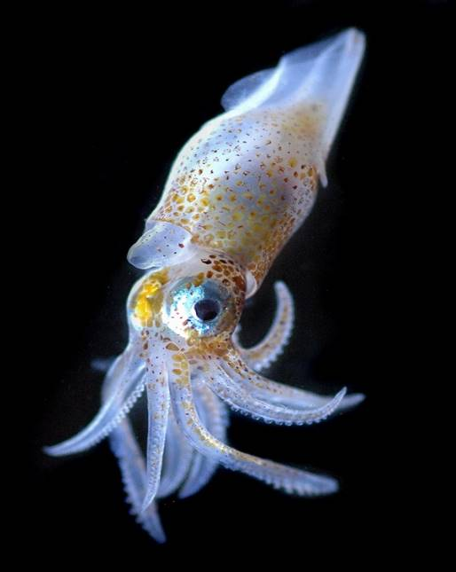
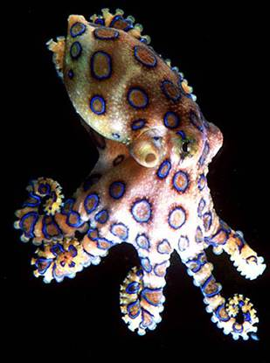
Mollusks

Slide 2
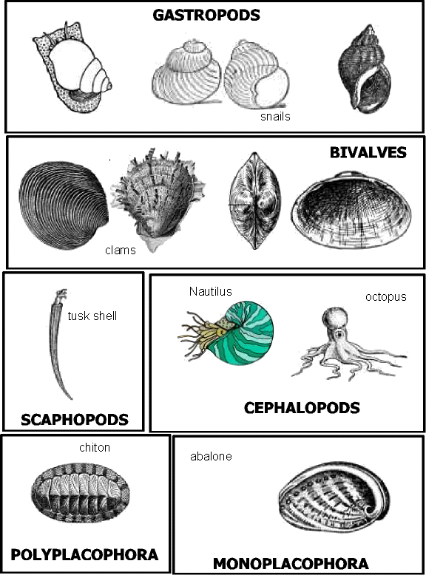
Phylum Mollusca
Over 100,000 species of mollusks
7 recognized classes of Mollusca
Bivalvia
Gastropoda
Cephalopoda
Scaphopoda
Polyplacophora
Monoplacophora
Aplacophora

Slide 3
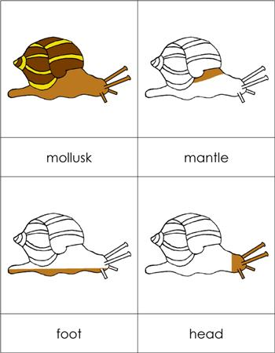
All mollusks have:
Bilateral symmetry
Soft bodies
Head
Foot
Mantle
Coiled visceral mass
(internal organs)
Internal or external shell (in most)
Brain

Slide 4
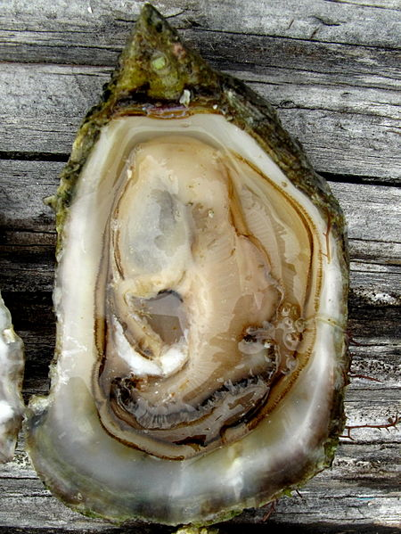
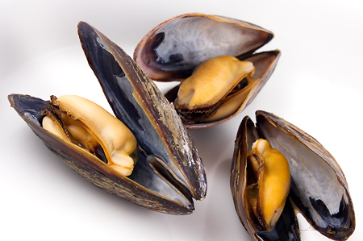
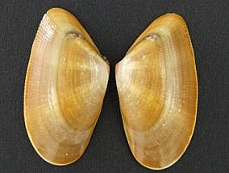
Class Bivalvia
Also called Class Pelecypoda
Bivalve – means 2 shells
Common bivalves include clams, oysters, and mussels
Oysters
mussels
clams

Slide 5
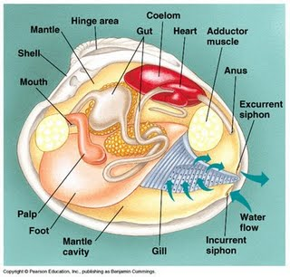
Bivalve Anatomy
Adductor muscles – used to keep shell closed.
Mantle – membrane that lines the inside of the shells and secretes calcium carbonate which builds the shell.
Gills
Incurrent Siphon – draws in water
Excurrent Siphon – expels water
Muscular foot – used to dig in sand

Slide 6
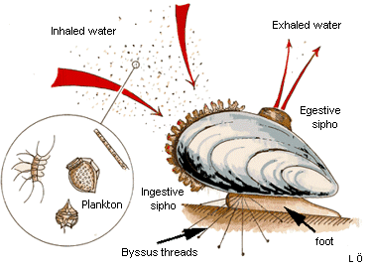
Feeding Behavior
Filter Feeders – burrow in the sand using its foot and extends its siphons and draws in water

Slide 7
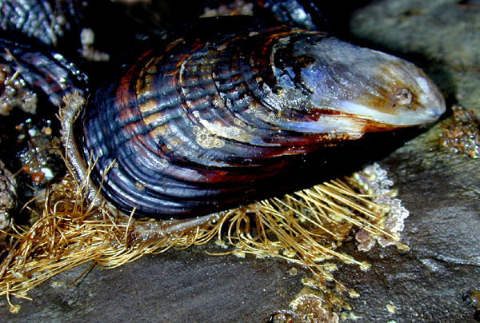
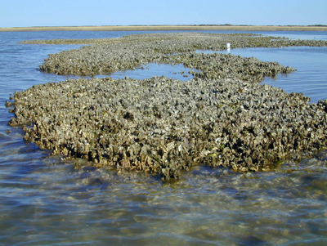
Mussels
Mussels can attach to rocks by secreting byssal threads from a gland inside the foot.
Oysters
Oysters can attach to a substrate by secreting a cement-like substance from the lower shell.

Slide 8
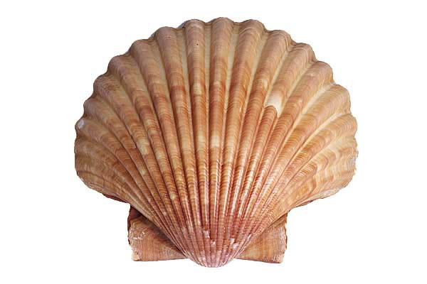
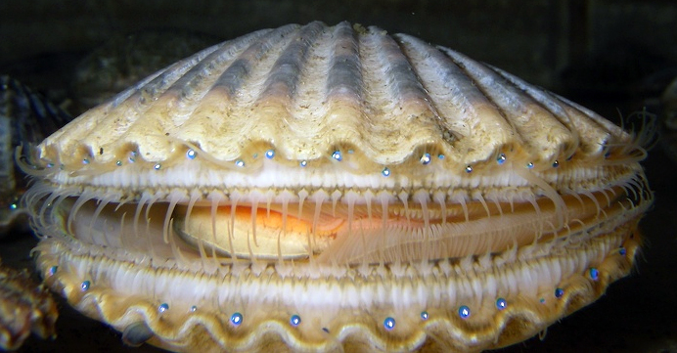
Scallops can “swim” to escape predators
Simple eyes line the outer edges and help the scallop sense light and movement
Scallops swimming video

Slide 9
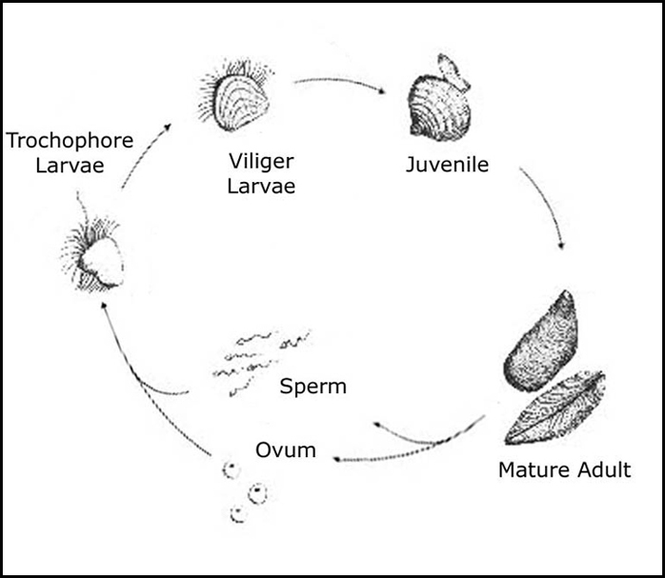
Reproduction in Bivalves
External fertilization
External development
Larval stage is planktonic
When the shell develops they settle to the seafloor and mature into adults

Slide 10
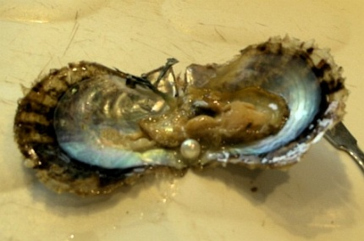
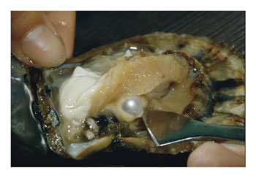
Pearls
A pearl is formed in an oyster when a grain of sand gets lodged in between the mantle and the shell
The mantle tissue reacts to the grain as a foreign body and secretes layers of shell around it– (nacre) forming the pearl.
pearl video

Slide 11
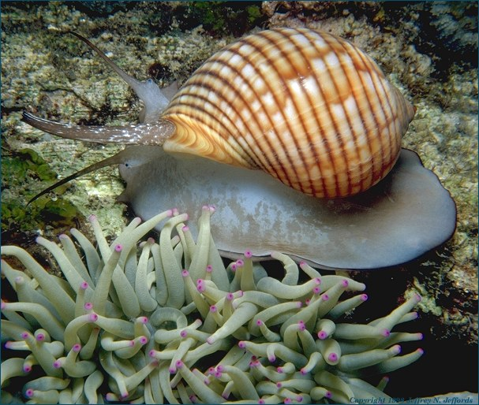
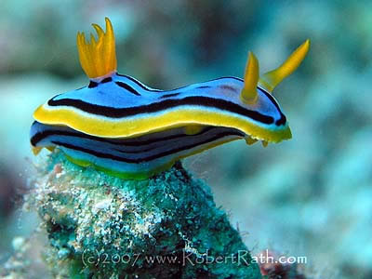
Class Gastropoda
AKA the univalves (one shell)
Gastropod means “stomach-foot”
Snails and sea slugs are common gastropods.

Slide 12
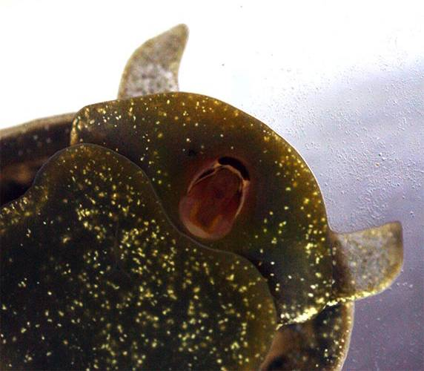
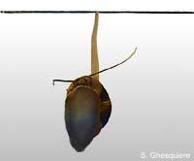
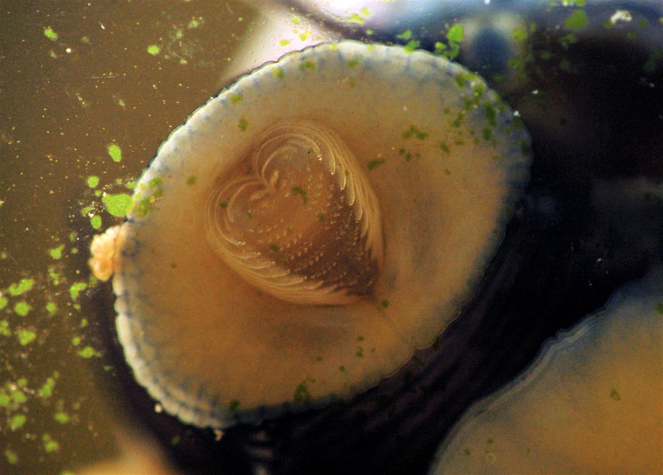
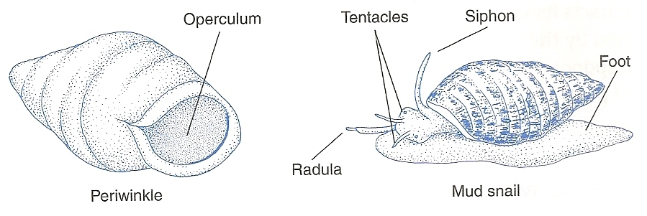
Radula – tongue-like structure lined with denticles used to scrape off and ingest food
Siphon – tube used to draw in oxygenated water for breathing
Radula
Siphon
Radula

Slide 13
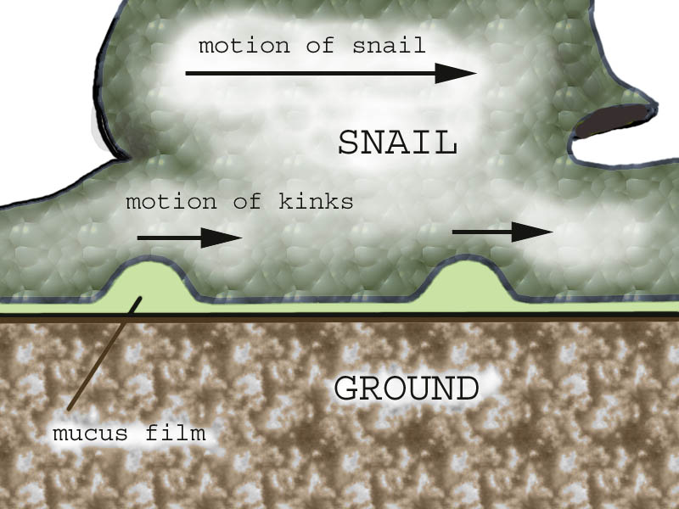
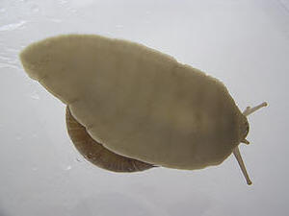
Foot – used for locomotion
Operculum – thick tissue that covers the foot
foot locomotion for snails video

Slide 14
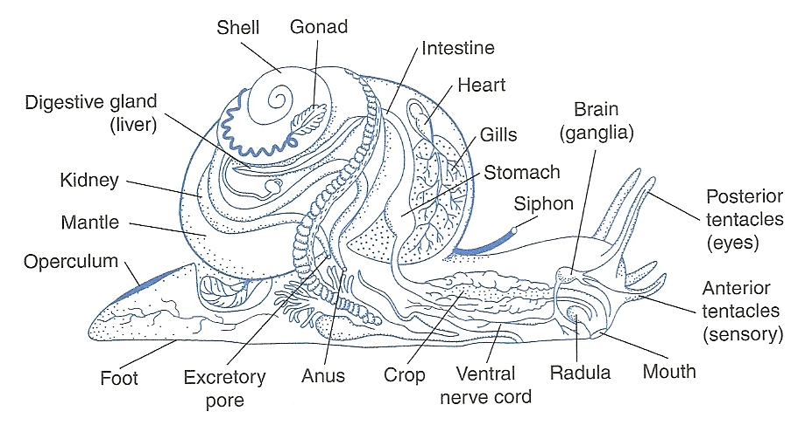
One-way digestive tract
Open circulatory system
One-chambered heart

Slide 15
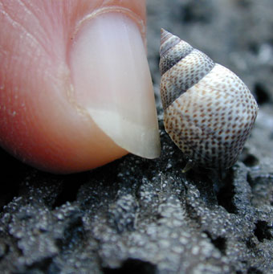
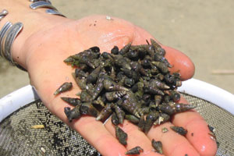
Feeding habits of Gastropods
Herbivores
The Periwinkle grazes on algae that grows on rocks
Scavengers
The Mud Snail feeds on dead or dying organisms

Slide 16
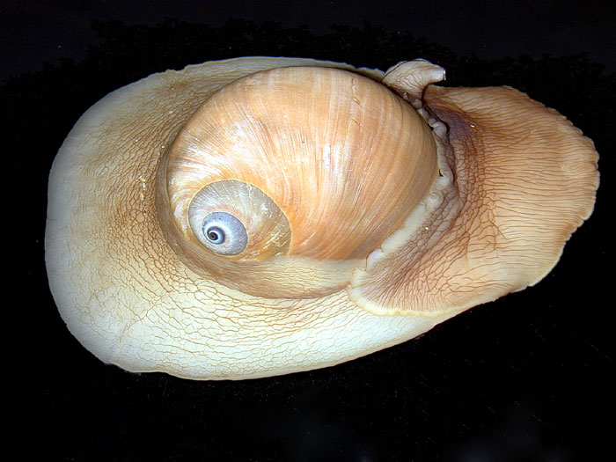
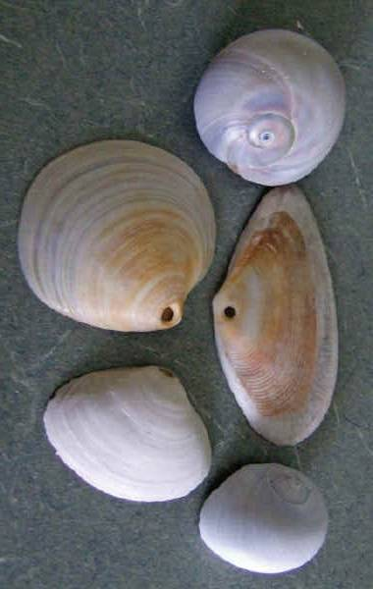
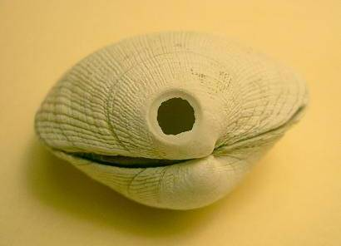
Feeding habits of Gastropods
Predators
The Moon Snail feeds on live clams
The snail secretes chemicals from a gland in its foot to soften the clam’s shell.
It then uses its radula to drill a hole through the shell
The snail then inserts its mouth through the hole and eats the soft-bodied clam

Slide 17
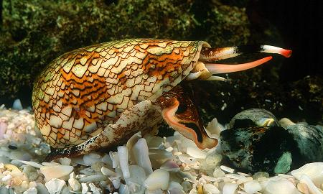
Another Predators
The Cone Snail uses toxins to kill its prey
A harpoon-like radula at the end of the snail’s proboscis is used to spear the prey, and deliver poison
The potent toxins that these snails produce are being studied by scientists for their use in pain reliever medications.
Cone Snail eating Clown Fish video

Slide 18
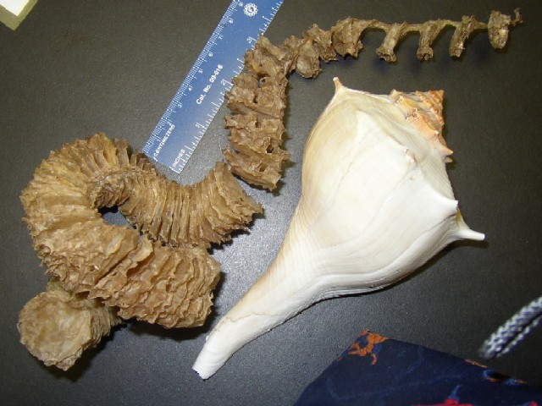
Reproduction in Snails
Some are hermaphrodites
Some have separate sexes
Internal fertilization
External development
Some females deposit fertilized eggs directly into water
Others enclose developing eggs in a protective covering
Whelk egg casing – aka “mermaid’s necklace”
Whelk egg casing video

Slide 19
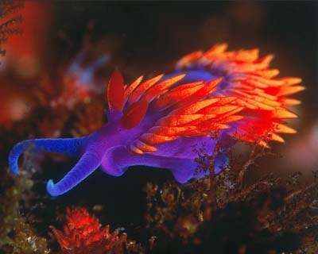
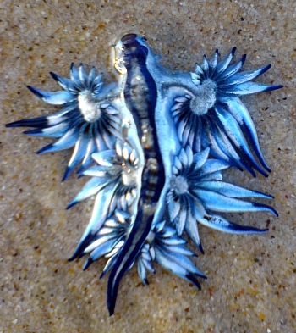
NUDIBRANCHS!!
A shell-less gastropod
Dramatic coloration = warning to predators!
Nudibranchs video

Slide 20
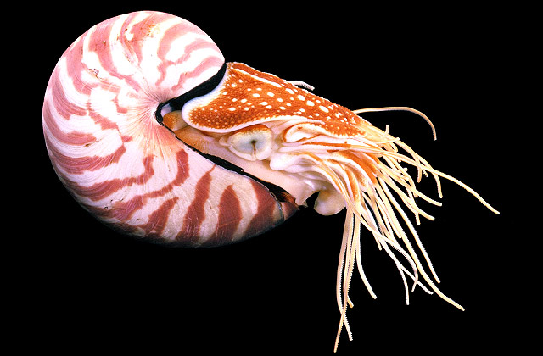
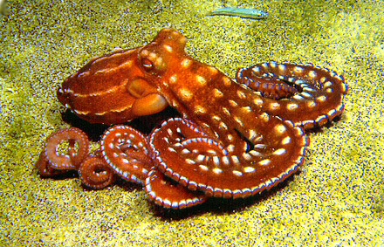
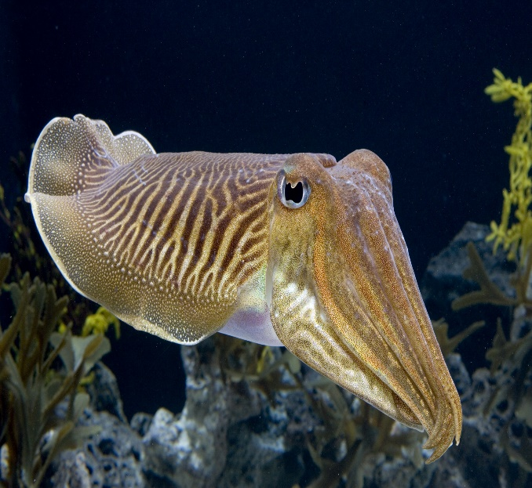
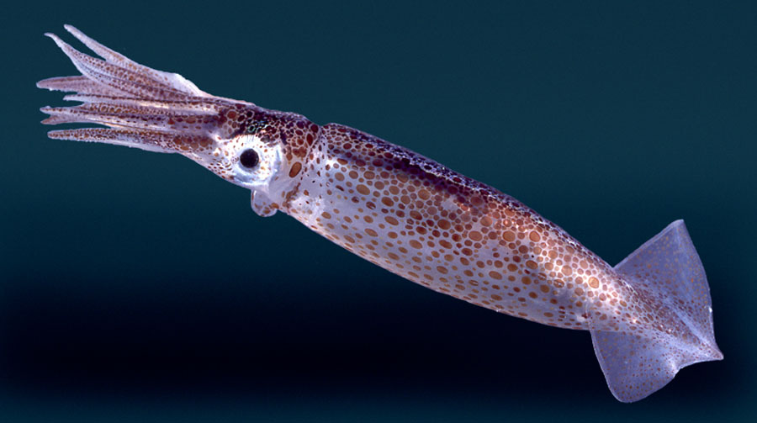
Class Cephalopoda
Cephalopod means “head – foot”
Most lack an external shell
Swims by a kind of jet propulsion
Water is drawn into the mantle cavity
Mantle contracts and water is expelled through the siphon.
The animal moves in the opposite direction
Highly intelligent
Includes octopus,
squid, cuttlefish,
and chambered
nautilus

Slide 21
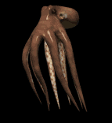
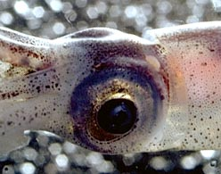
Typical Structures and Behaviors
Large head and large eyes
Tentacles (modified foot)– used to capture prey
Suction discs line tentacles – used to grasp/hold prey and to climb and crawl along the seafloor
Chromatophores – specialized pigment cells that expand and contract to change color or pattern
Most discharge some sort of ink to confuse predators
Highly developed brain and eyes.
All species are marine

Slide 22
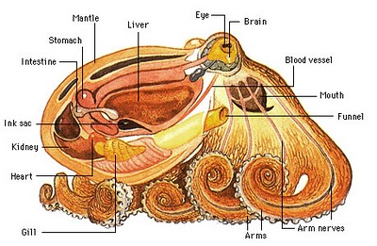
Octopus
8 tentacles lined with suction discs
Powerful parrot like beak – sometimes armed with venom
Blue blood!! Hemocyanin – O2 carrier in blood
3 hearts to keep blood pressure high to deal with low oxygen levels
Lifespan is only 3 – 5 years
Chromatophores
No shell
Ink! Octopus Video

Slide 23
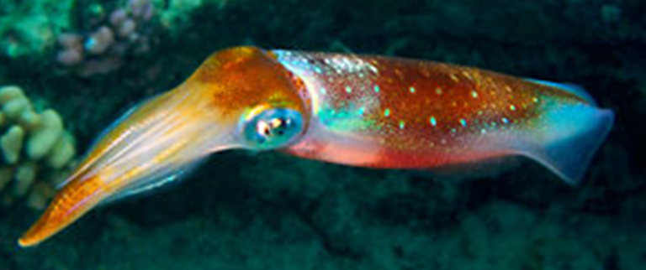
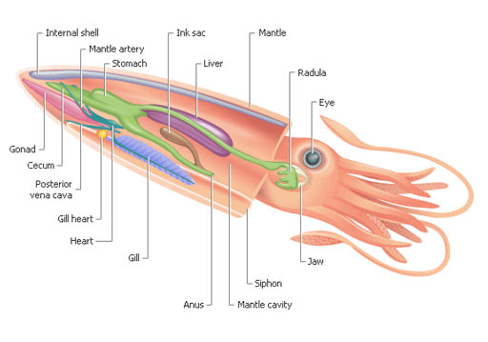
Squid
10 tentacles
(8 “arms”2 longer tentacles”)
Reduce internal shell called a “pen”
Beak-like mouth
Chromatophores
Blue blood – also
has hemocyanin
like octopus
Life span 1-2 years
Squid video

Slide 24
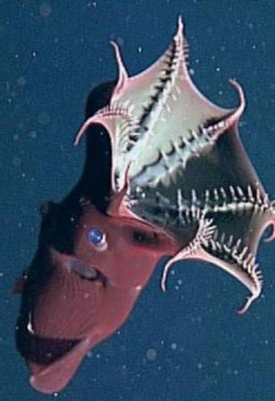
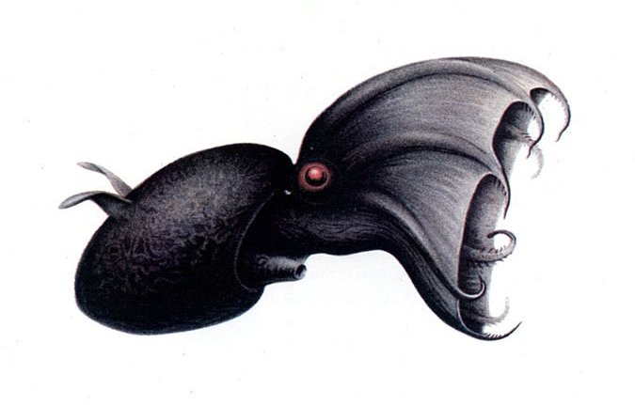
Vampire Squid
Vampyroteuthis infernalis, literally translates as “vampire squid from hell”
Vampire Squid video

Slide 25
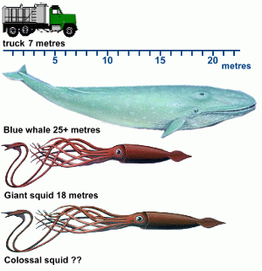
The Colossal Squid
Largest invertebrate – up to 46 feet long!
Suction cups have large swiveling hooks
Largest eyes – 11 inches in diameter!

Slide 26
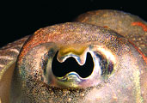
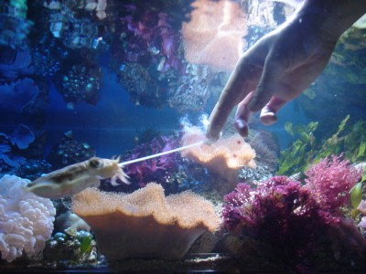
Cuttlefish
Internal shell called the cuttlebone
8 arms, 2 longer tentacles
Many people keep cuttlefish as pets
Strange eyes - “W-shaped” pupils
cuttlefish video

Slide 27
Chambered Nautilus
90 tentacles – no suckers
Eyes not as advanced
As the animal matures, it moves forward and cuts off each chamber
Siphuncle penetrates each chamber and functions in buoyancy control – pumps water into and out of chambers
chambered nautilus video

Slide 28
Class Scaphopoda
The tusk shells
Means “shovel-footed”
Shell is tube-like and open on both ends
Foot used to dig in sand and eat detritus

Slide 29
Class Polyplacophora
“Many plates”
AKA Chitons
8 overlapping shells
No eyes or tentacles
Inhabit rocky intertidal zones
As it moves, it feeds (like a snail) by scraping algae off rocks using its radula
Chitons video

Slide 30
Class Monoplacophora
“One plate”
Only 11 living species
Possess single cap-like shell
Most live at great depths
Segmented like worms – so may be more closely related to segmented worms than molluscs

Slide 31
Class Aplacophora
Without a shell
Worm like
About 100 species
Most live at great depths
No real means of locomotion
Reduced foot – only pedal groove

