Slide 1
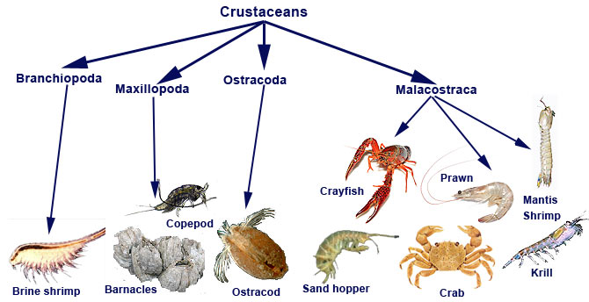
Crustaceans

Slide 2
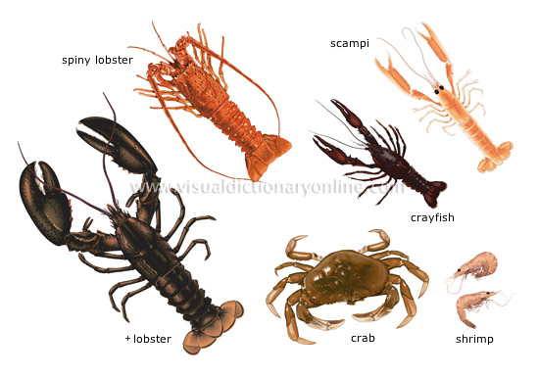
Crustacean Basics
Phylum Arthropoda
Jointed appendages
Exoskeleton made of chitin
Most undergo molting to grow

Slide 3
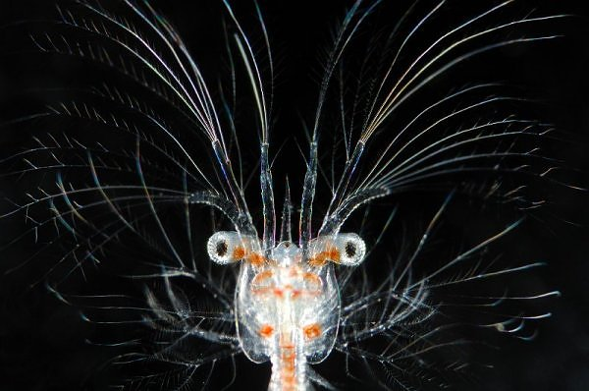
Crustacean Features
2 segments
Cephalothorax – head and chest region
Abdomen – including tail (if present)
Carapace – part of exoskeleton that covers head and chest
Lobsters, crabs, and shrimp have 5 pairs of legs and are called the decapods (“10 legs”)

Slide 4
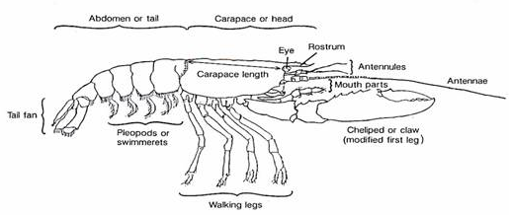
Crustacean Features
Head
2 eyes
2 pairs of antennae
Mouthparts for feeding
Thorax
Food-getting appendage (usually claws)
The walking legs
Some have swimmerets – small paddlelike appendages

Slide 5
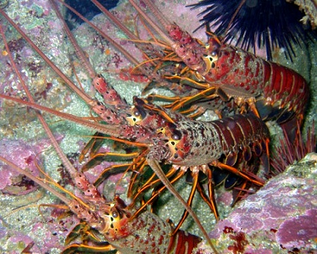
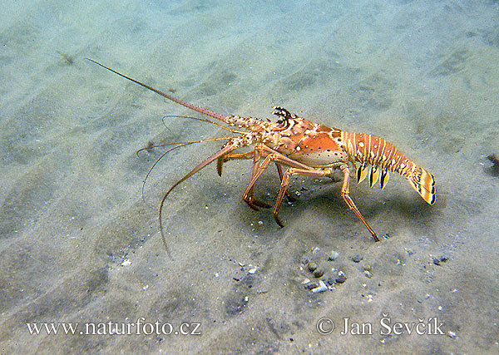
The Lobster
The spiny lobster – found in Gulf of Mexico
Known to be aggressive towards each other
Can regenerate appendages
Predators, but may also scavenge on the remains of dead animals
Annual migration

Slide 6
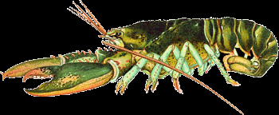
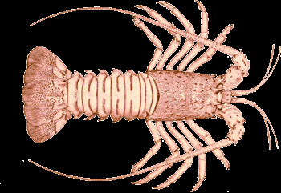
American Lobster and Spiny Lobster
The American lobster has claws on its first 4 legs, lacking in the spiny lobster
The spiny lobster has a pair of horns above the eyes, lacking in the true lobster

Slide 7
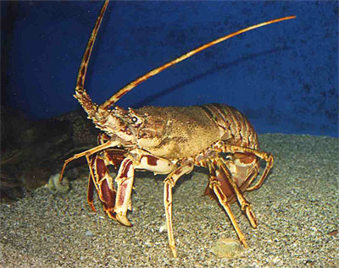
The Lobster
One way digestive tract
Breathes using gills
Blue blood because of hemocyanin – an O₂ binder
One chambered heart
Open circulatory system
Antennae used as sensory receptors

Slide 8
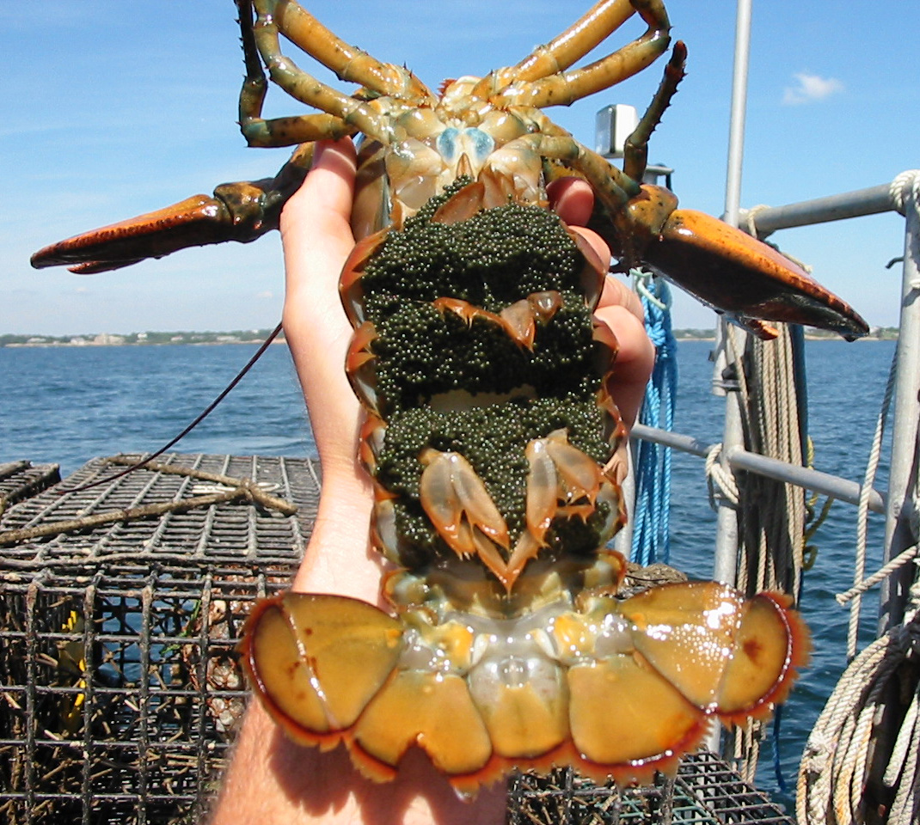
The Lobster
Lobsters reproduction video
Sexual reproduction
Female carries fertilized eggs on her swimmerets for about a year before they hatch
She is called a “berried female”
Fishermen must release her if caught.
Planktonic larval stage.

Slide 9
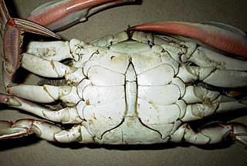
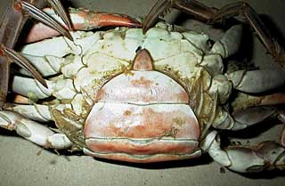
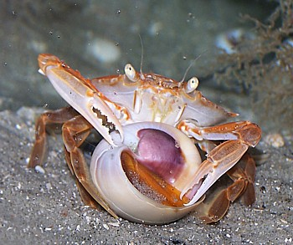
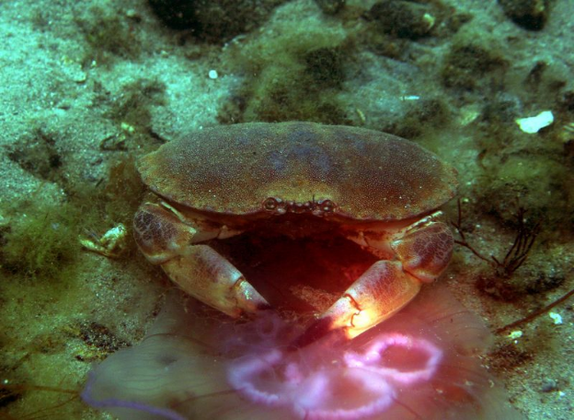
The Crab
Male
Two body segments – cephalothorax and abdomen
No tail
Sex of the crab is indicated on its underbelly.
Diet
Mainly dead plant and animal matter
Some are herbivores – feeding mostly on algae
Some are predatory
Claws are used to shred food
Mouthparts tear food into even smaller pieces
Female

Slide 10
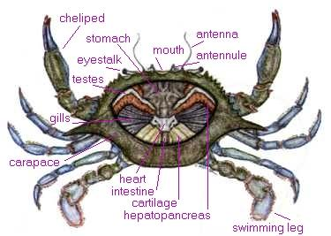
The Crab
One way digestive tract
Breathes using gills
Open circulatory system
One chambered heart

Slide 11
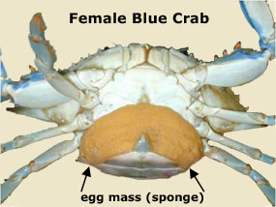
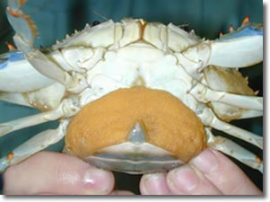
The Crab
Internal fertilization
External development
Females can retain sperm for months. This allows her to fertilize her eggs when conditions are most favorable. Eggs hatch in about 2 weeks.
Average is about 2 million eggs!
Only about 1 in a million will
survive to adulthood!
She is called a sponging crab
while she is carrying eggs.
Fishermen must release her
immediately if she is caught.

Slide 12
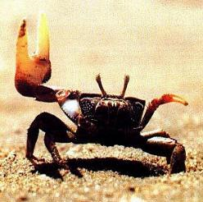
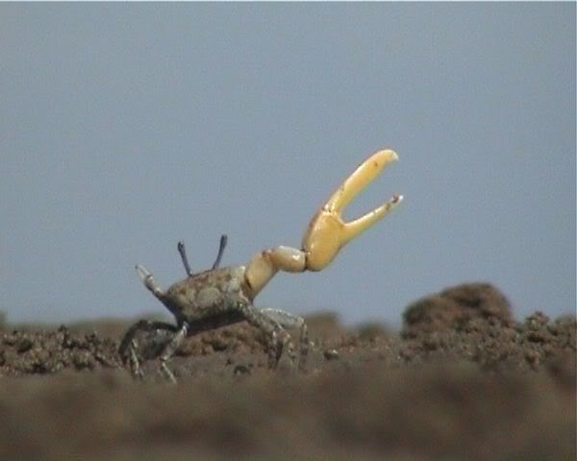
fiddler crab video
The Fiddler Crab
Females have 2 small claws
Males have one large claw and one small one
Can regenerate new claws if they lose them
If the male loses his large claw, it will regenerate a new small one and the other one grows into a large claw
Burrow in small holes in the sand
A fiddler crab shows off his moves – he waves his brightly colored claw to impress the female crab.

Slide 13
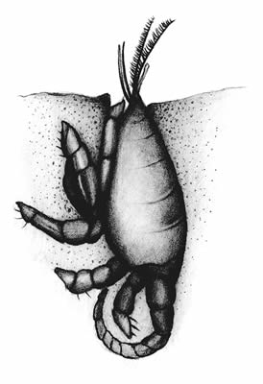
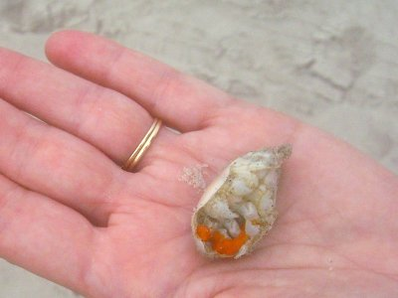
The Mole Crab
Lives in the surf zone
Mostly Atlantic and Pacific regions
Buries itself in the sand
Extends its featherlike antennae to capture microscopic organisms

Slide 14
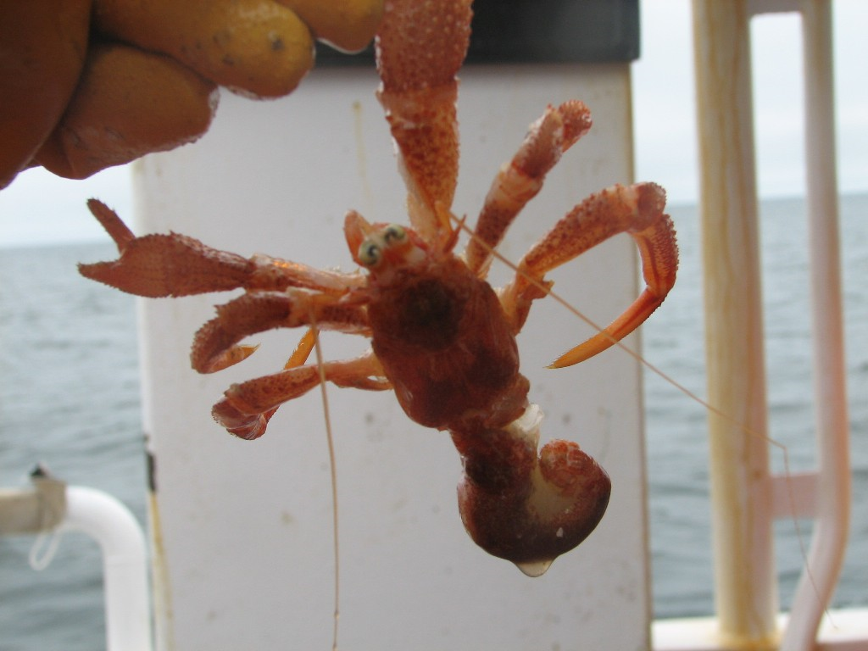
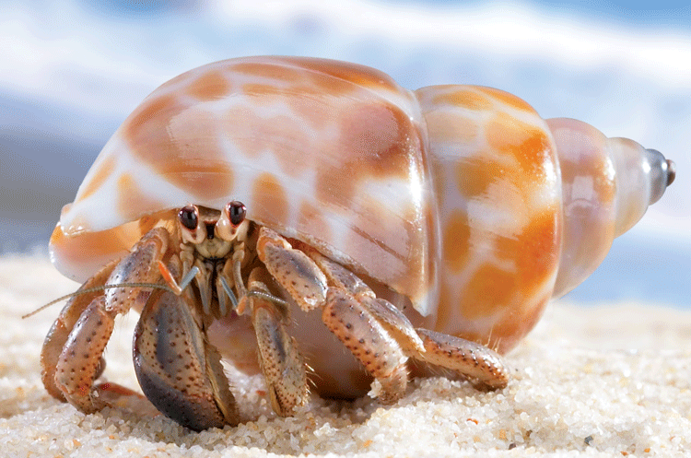
The Hermit Crab
Actually is NOT born with a shell!
Finds an empty shell to live in.
As it grows, it has to find a larger shell to move into
Inhabit shallow coastal waters
Scavengers mostly
Hermit Crab changing shells video

Slide 15
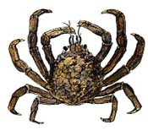
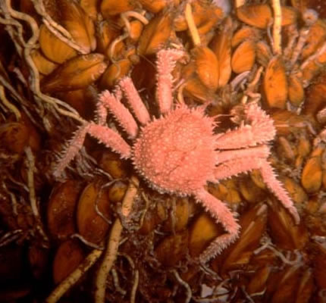
The Spider Crab
Very slow moving
No paddle-like appendages for swimming or digging
Pointed legs used for crawling on the ocean floor
Algae and barnacles likely to grow on its shell
Inhabits Atlantic and Pacific regions
Scavenges mostly

Slide 16
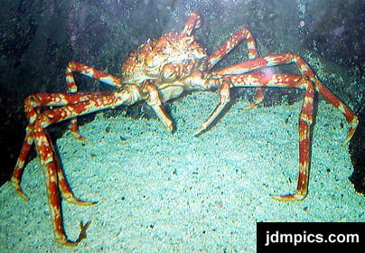
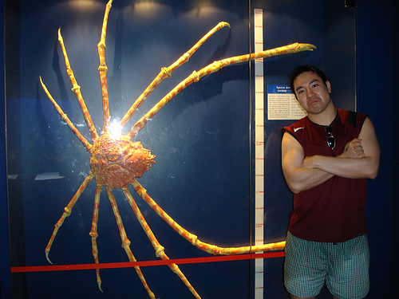
The Crab
The Giant Spider Crab!!
Largest crab
Found in deep water s off the coast of Japan
Leg tip to leg tip = 4 meters!! (almost 12 feet long!!)

Slide 17
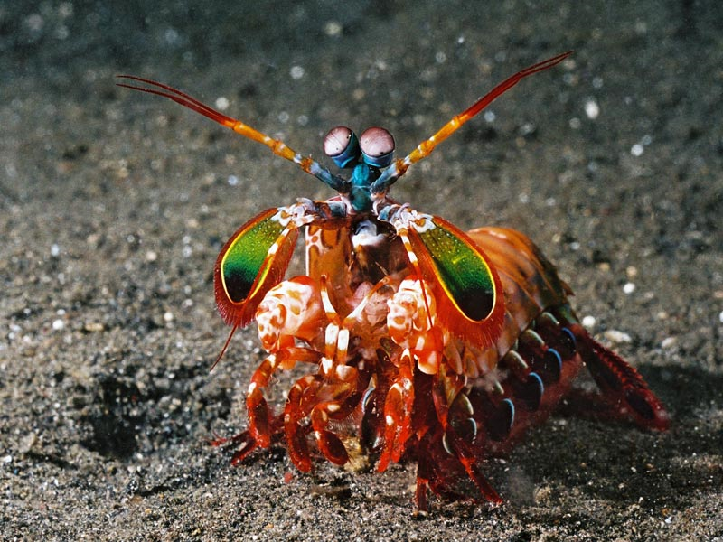
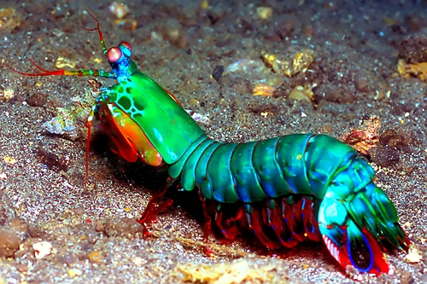
The Shrimp
Mantis Shrimp video
Kinda like a small version of the lobster
Over 2800 described species
Gulf Shrimp – very popular shrimp for food
Mantis shrimp –largest of all shrimp at about 10 inches!

Slide 18
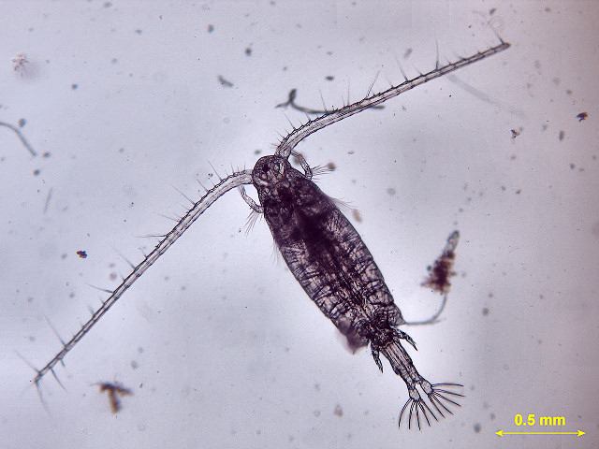
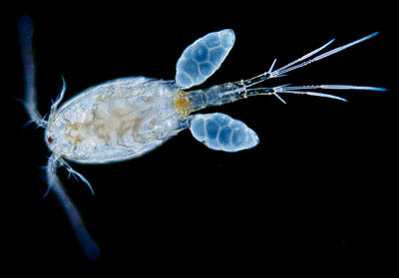
Copepods and Krill
Copepods - means “Oar feet”
most abundant crustacean in the ocean
Over 4500 species
Feeds mainly on diatoms – so lives near ocean surface
Main food source for many animals

Slide 19
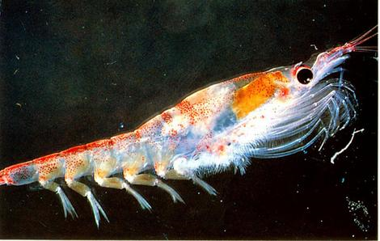
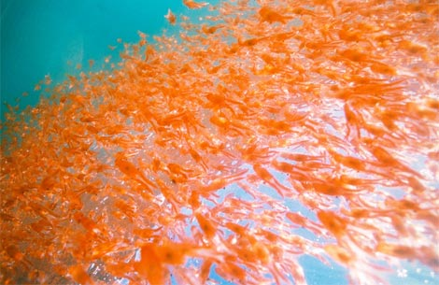
Copepods and Krill
Krill
Looks like a shrimp but has more than 10 legs – so its not a decapod
Most live in Arctic waters
Feeds mainly on diatoms – so lives near ocean surface
Main food source for many animals

Slide 20
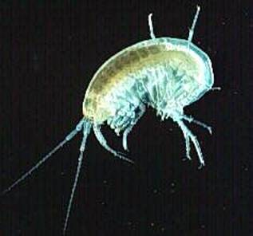
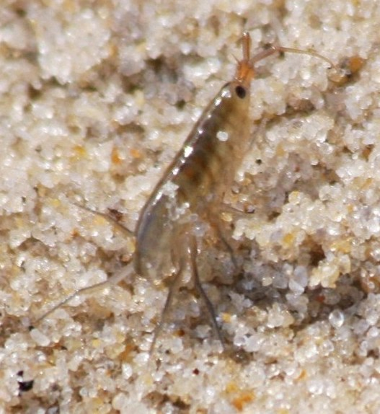
Amphipods and Isopods
These are bottom dwelling crustaceans
Amphipods –means “both kinds of feet”
Feet used for many purposes – jumping, walking, swimming, feeding, etc
Scuds and beach fleas
Feed on small inverts in the wet sand and on seaweed
Look like tiny shrimps that have flattened sides

Slide 21
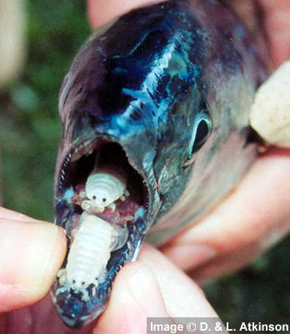
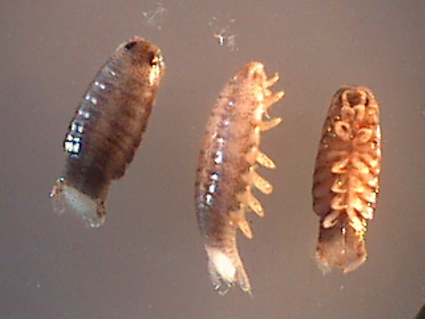
Amphipods and Isopods
Isopods – means “same foot”
Several pairs of feet – all the same size
Flattened bodies (from top to bottom)
7 pairs of legs
Some are herbivores
Some are parasitic

Slide 22
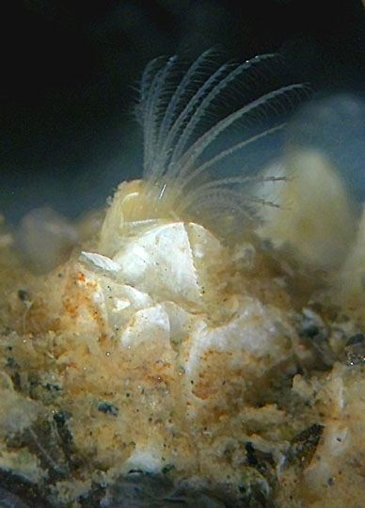
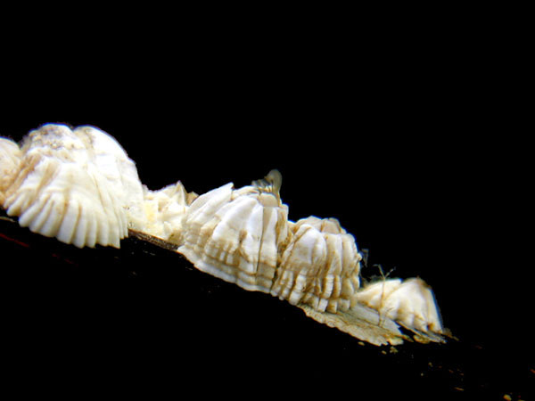
The Barnacle
The barnacle’s body lies folded within its shell
It feeds by extending its cirri to catch plankton
Considered to be a filter feeder because they filter plankton and organic debris from the water
Settles onto a substrate (as a larva) and secretes a glue-like substance to attach themselves, and then develop into adult barnacles
Balanus barnacles

Slide 23
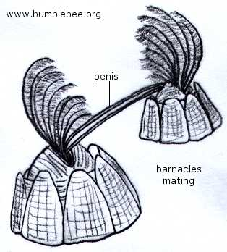
The Barnacle
Barnacle Video
It’s a hermaphrodite – has both sex organs
Can NOT self fertilize though
An actual penis inserts sperm into the shell of a neighboring barnacle
Swimming larvae are shed into the water

Slide 24
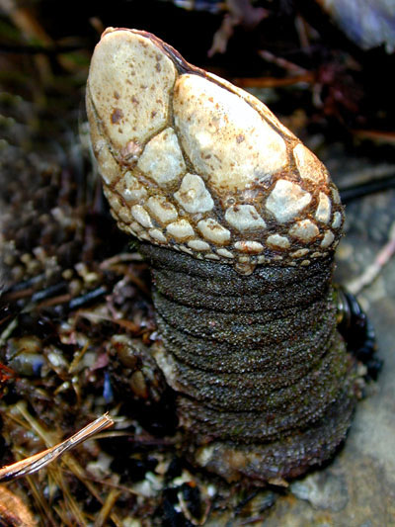
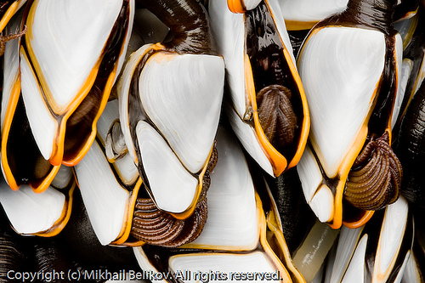
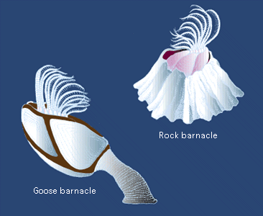
The Barnacle
Gooseneck barnacles!
Named for the shape of their stalk
Able to bend in the current to capture plankton
6 pairs of cirri extend to snatch up the prey

Slide 25
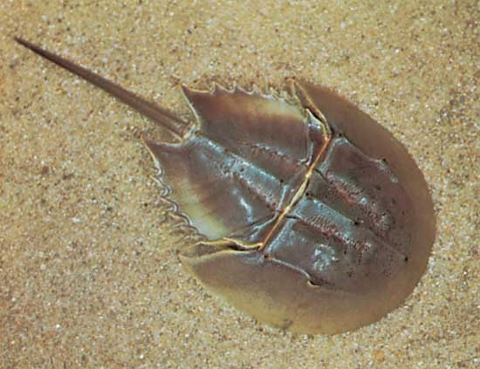
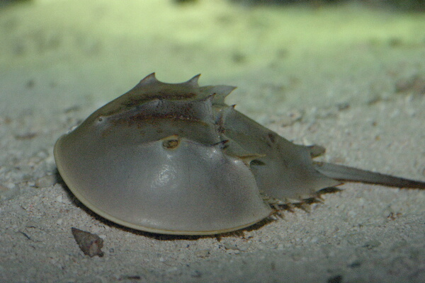
The Horseshoe Crab
Hermit Crab video # 2
NOT A TRUE CRAB! NOT EVEN A CRUSTACEAN!
More closely related to spiders and scorpions!
Class Merostomata (same phylum – Arthropoda)
Inhabits Atlantic and Gulf Coasts
Feeds on small mollusks and crustaceans

Slide 26
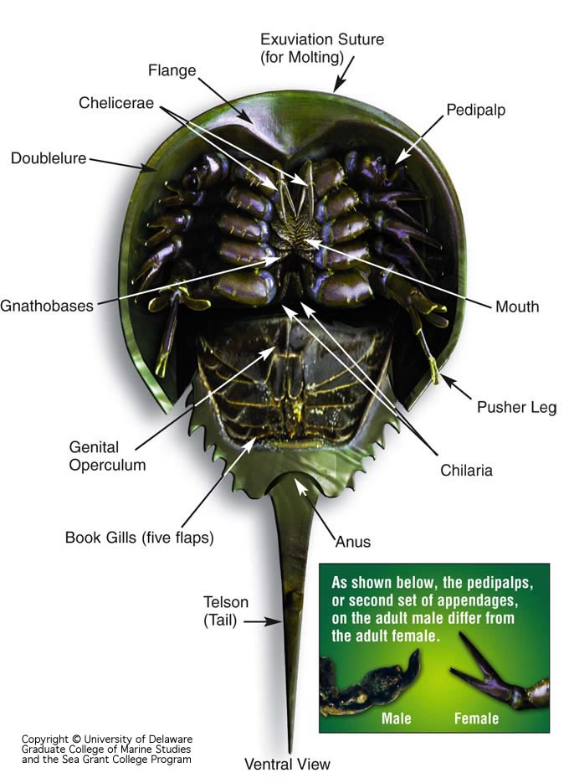
The Horseshoe Crab
4 eyes – 2 simple eyes and 2 compound eyes
Book gills
6 pairs of legs
1st set of legs are pinching claws
In males, the 1st claw is shaped like a boxing glove.
The rest are walking legs
Telson – spiked tail – used to flip itself over

Slide 27
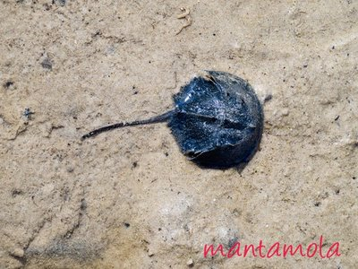
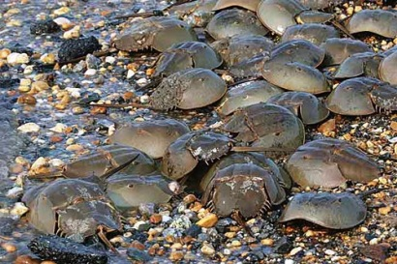
The Horseshoe Crab
Late spring…
1000s of horseshoe crabs invade sandy beaches and marshes to lay their eggs
Swimming juveniles hatch in about 2 weeks and are carried out with the tide
Lifespan – 20 years!

